Slide 1
DATA SCIENCE
10 WEEK PART TIME COURSE
Super-charging Decision Trees

Slide 2
AGENDA
One-hot encoding
Decision Tree Regression
Bagging
Ensembling
Random Forest
Boosting
Lab
Other Uses
Discussion

Slide 3
ONE-HOT ENCODING
DATA SCIENCE PART TIME COURSE

Slide 4
You have a set of categories, you need some numbers
Station | Year | Line
Central | 2015 | City
Town Hall | 2012 | City
Parramatta | 2015 | West
Chatswood | 2014 | Northern
St Leonards | 2012 | Northern
Station | Year | City | West | Northern
Central | 2015 | 1 | 0 | 0
Town Hall | 2012 | 1 | 0 | 0
Parramatta | 2015 | 0 | 1 | 0
Chatswood | 2014 | 0 | 0 | 1
St Leonards | 2012 | 0 | 0 | 1

Slide 5
We’ve done this before for simple cases
Titanic[’Gender’] =
[0 if x == ’male’ else 1 for x in Titanic[’Sex’] ]
Titanic[’Gender’] = numpy.where(Titanic[’Sex’] == ’male’,0,1]

Slide 6
sklearn.preprocessing does simple cases automatically
import sklearn.preprocessing
Label_enc = sklearn.preprocessing.LabelEncoder()
Titanic[’Gender’] = Label_enc.fit_transform(Titanic[’Sex’])
print Label_enc.classes_
print Label_enc.inverse_transform([0, 1])

Slide 7
Set + for loop for more complicated cases
Trains = pandas.read_csv(‘data/sydtrains.csv’, …)
All_Lines = set(Trains.LINE)
for line in All_Lines:
Trains[line] = numpy.where(Trains.LINE == line,1,0)

Slide 8
OneHotEncoder can do this semi-automatically
Used_Vehicles = pandas.read_csv(‘data/used_vehicles’)
Label_enc = sklearn.preprocessing.LabelEncoder()
Used_Vehicles[’ENCODED’] =
Label_enc.fit_transform(Used_Vehicles.type)
Hot = sklearn.preprocessing.OneHotEncoder(sparse=False)
Temp = Hot.fit_transform(Used_Vehicles[[‘ENCODED’]])
Temp_DF = pandas.DataFrame(Temp,
columns=Label_enc.classes_)
New_Frame = Used_Vehicles.merge(Temp_DF,
left_index=true,
right_index=true
)

Slide 9
DECISION TREE REGRESSION
DATA SCIENCE PART TIME COURSE

Slide 10
DecisionTreeRegressor
Predict a number instead of a category
Each node in the tree tries to break the data into the two categories with the smallest mean sample error
import sklearn.tree
DF = …
DTR = sklearn.tree.DecisionTreeRegressor(max_depth=3)
DTR.fit(DF[col1, col2,…], DF.numeric_column)
DTR.predict(…)
sklearn.tree.export_graphviz(DTR, out_file=…, features=[col1, col2, …])

Slide 11
But of course, you would use GridSearchCV
The scoring parameter for a regression is usually ‘mean_squared_error’
Only one criterion is available (‘mse’)
Can still use max_features
params = {‘max_depth’: range(1,20)}
brute_force = GridSearchCV(DTR,
params,
cv=6,
scoring='mean_squared_error')

Slide 12
How do we improve decision trees?
DATA SCIENCE PART TIME COURSE

Slide 13

DECISION TREES

Slide 14

DECISION TREES

Slide 15
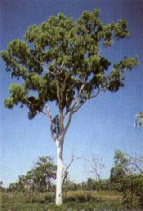
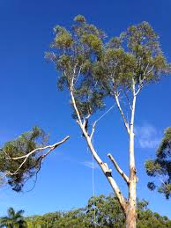
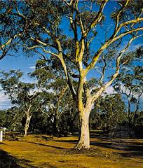
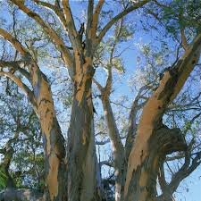
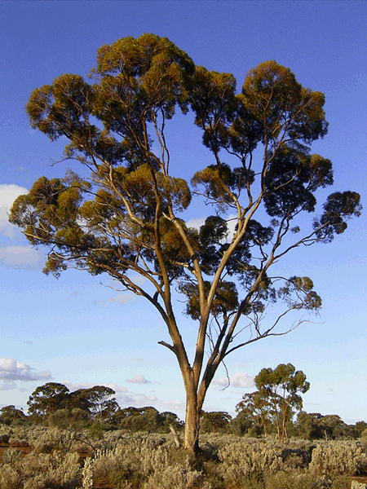
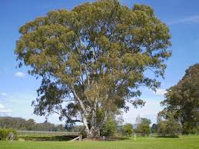
DECISION TREES

Slide 16
ENSEMBLING
DATA SCIENCE PART TIME COURSE

Slide 17
ENSEMBLE MODELS
Ensemble learning (or "ensembling") is simply the process of combining several models to solve a prediction problem, with the goal of producing a combined model that is more accurate than any individual model.
For classification problems, the combination is often done by majority vote.
For regression problems, the combination is often done by taking an average of the predictions.

Slide 18
ENSEMBLE MODELS - WHEN DO THEY WORK?
For ensembling to work well, the individual models must meet two conditions:
Models should be accurate (they must outperform random guessing)
Models should be independent (their predictions are not correlated with one another)

Slide 19
Some examples
You run a journalism / fiction site. What makes some website content evergreen (always interesting)?
What makes a house valuable on AirBNB?
When will my mining truck break down?

Slide 20
BAGGING
DATA SCIENCE PART TIME COURSE

Slide 21
BOOTSTRAP & BAGGING
Bootstrapped Aggregation = Bagging
The bootstrap is a statistical technique that is used to quantify the uncertainty of a model
Bootstrap samples are simply random samples with replacement

Slide 22
BAGGING
What is the bagging process?
Take repeated bootstrap samples (random samples with replacement) from the training data set
Train our method on each bootstrapped training set and make predictions
Average the predictions

Slide 23
BAGGING
This increases predictive accuracy by reducing the variance, similar to how cross-validation reduces the variance associated with the test set approach (for estimating out-of-sample error) by splitting many times an averaging the results.

Slide 24
BAGGING
Specifically to Decision Trees
Grow B regression trees using B bootstrapped training sets
Grow each tree deep enough that each one has low bias
Every tree makes a prediction, and the predictions are merged (average? vote?) to reduce the variance
What value should be used for B?

Slide 25
Bagging Classifier
import sklearn.ensemble
Bag = sklearn.ensemble.BaggingClassifier(
n_estimators=5,
max_samples=10,
max_features=2,
n_jobs=-1
)
Bag.fit(DF[[…]], DF.target)
for i in range(len(Bag.estimators_)):
sklearn.tree.export_graphviz(Bag.estimators_[i],
out_file=“filename%d.dot” % i,
features_names=…
)
Ran out of room to fit GridSearchCV on this slide

Slide 26
Things that bootstrap nicely
Decision Trees
Perceptrons
Ordinary least squares (turns it into Theil-Sen)
Why would it be stupid to bootstrap:
Theil-Sen regressor?
KNearestNeighbours?

Slide 27
DECISION TREES
HOW DO WE IMPROVE BAGGED DECISION TREES ?

Slide 28
RANDOM FORESTS
DATA SCIENCE PART TIME COURSE

Slide 29
RANDOM FORESTS
Random Forests is a slight variation of bagged trees that has even better performance! Here's how it works:
Exactly like bagging, we create an ensemble of decision trees using bootstrapped samples of the training set.
However, when building each tree, each time a split is considered, a random sample of m predictors is chosen as split candidates from the full set of p predictors. The split is only allowed to use one of those m predictors.

Slide 30
RANDOM FORESTS
However, when building each tree, each time a split is considered, a
random sample of m predictors
is chosen as split candidates from the
full set of p predictors.
The split is only allowed to use one of those
m predictors.

Slide 31
RANDOM FORESTS
Notes:
A new random sample of predictors is chosen for every single tree at every single split.
For classification, m is typically chosen to be the square root of p. For regression, m is typically chosen to be somewhere between p/3 and p.

Slide 32
RANDOM FORESTS
What's the point?
Suppose there is one very strong predictor in the data set. When using bagged trees, most of the trees will use that predictor as the top split, resulting in an ensemble of similar trees that are "highly correlated".
Averaging highly correlated quantities does not significantly reduce variance (which is the entire goal of bagging).
By randomly leaving out candidate predictors from each split, Random Forests "decorrelates" the trees, such that the averaging process can reduce the variance of the resulting model.

Slide 33
VARIABLE IMPORTANCE
Although bagging increases predictive accuracy, it decreases model interpretability because it's no longer possible to visualize the tree to understand the importance of each variable.
To compute variable importance for bagged regression trees, we can calculate the total amount that the mean squared error is decreased due to splits over a given predictor, averaged over all trees.
A similar process is used for bagged classification trees, except we use the Gini index instead of the mean squared error.

Slide 34
RandomForestRegressor / RandomForestClassifier
Rfr = sklearn.ensemble.RandomForestRegressor(n_jobs=-1,
n_estimators=20)
… etc

Slide 35
DECISION TREES
WHAT ELSE COULD WE DO TO IMPROVE DECISION TREES ?

Slide 36
BOOSTING
DATA SCIENCE PART TIME COURSE

Slide 37
BOOSTING
Boosting involves the base learners being built sequentially (using previous models). The aim is to reduce the bias of the combined estimator.
Compare this to something like bagging where the models are built independently of one and other.

Slide 38
ADABOOST - ADAPTIVE BOOSTING
AdaBoost works by building sequential models on re-weighted versions of the data. Initially all data points have the same weighting = 1/N.
After the first model the error on the points is evaluated and the weighting for each observation is adjusted. So if we fit a model and an observation has a large difference between the observed and predicted we give that observation a higher weighting and run the model again.
This means observations that are difficult to predict become more influential in the model.

Slide 39
GRADIENT BOOSTING
Gradient Boosting is a technique that are sequentially fitted that minimise a loss function. For regression this might be the square loss. So we would be updating the model based on Gradient Descent.
This differs to AdaBoost where the boosting was performed by re-weighting the original observations.

Slide 40
eXtreme Gradient Boosting
XGBoost is an optimized distributed gradient boosting library designed to be highly efficient, flexible and portable. It implements machine learning algorithms under the Gradient Boosting framework. XGBoost provides a parallel tree boosting(also known as GBDT, GBM) that solve many data science problems in a fast and accurate way. The same code runs on major distributed environment(Hadoop, SGE, MPI) and can solve problems beyond billions of examples.
- https://github.com/dmlc/xgboost

Slide 41
sklearn.ensemble.*
AdaBoostClassifier | AdaBoostRegressor
BaggingClassifier | BaggingRegressor
GradientBoostingClassifier | GradientBoostingRegressor
RandomForestClassifier | RandomForestRegressor

Slide 42

LAB
DATA SCIENCE PART TIME COURSE

Slide 43
OTHER USES
DATA SCIENCE PART TIME COURSE

Slide 44
RANDOM FOREST FOR CLUSTERING
The idea is to create Synthetic data (fake data that is based on the original data set)
Then combine this fake data with your original data set
Assign a ‘Synthetic_data’ with 1 for the synthetic data and 0 for real data
Run the Random Forest model trying to predict ‘Synthetic_data’
You will have a ‘distance metric’ or ‘proximity’ which is basically how many times the samples occur in the same terminal nodes.

Slide 45
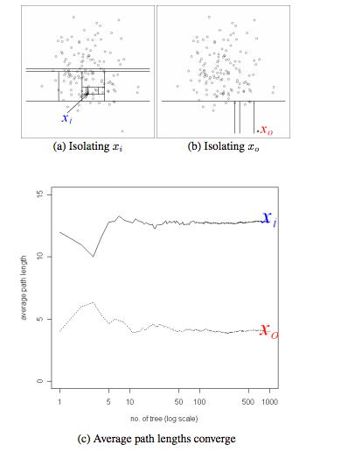
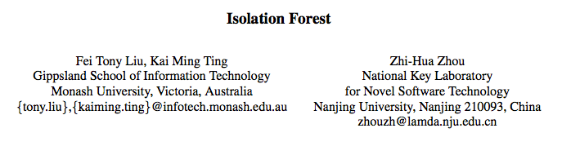
ISOLATION FOREST FOR OUTLIER DETECTION

Slide 46
DISCUSSION TIME
DATA SCIENCE

